Slide 1
India’s Duty Free Tariff Preference (DFTP) Scheme for Least Developed Countries (LDC)
10th CII – EXIM Bank Conclave on India Africa Project Partnership
10 March 2014

Slide 2
Mandate
Duty Free Quota Free (DFQF) market access under WTO’s Hong Kong Ministerial Declaration, 2005:
Developed countries and developing countries declaring themselves in a position to do so, to provide market access for at least 97% of products originating from LDCs.
Developing countries permitted to phase in their commitments and enjoy appropriate flexibility in coverage.

Slide 3
Objectives
Prime Minister of India announced the Duty Free Tariff Preference (DFTP) Scheme for all the LDCs in India Africa Forum Summit in April 2008. The Scheme has been implemented in 2008.
The objective of this Scheme is to grant unilateral tariff preferences on the exports of products originating in the LDCs on imports to India to improve their trading opportunities and use it as a tool for their development.
Though undertaken unilaterally, it is in line with the decision taken in the World Trade Organisation’s (WTO’s) Hong Kong Ministerial Declaration of December, 2005.

Slide 4
Eligibility
The Scheme is open to all the LDC members, a total of 49, including 34 LDCs in Africa, named as “Beneficiary Country”.
To become a “Beneficiary Country”, the interested LDC members are required to give a Letter of Intent to the Government of India that they wish to be covered under this Scheme and that they would comply with the provisions of this Scheme.
Unilateral Scheme, no conditions attached.

Slide 5
Modalities for Tariff Preferences
Duty Free List: 85% of the total tariff lines (at 6-digit HS) to become duty-free.
Positive List: On 9% tariff lines limited tariff concessions would be available (ranging from 10% to 100%).
Exclusion List: Only 6% of the tariff lines are excluded from the preferential tariff treatment.
Reduction process:
5 equal cuts
5 year implementation period
Rules of Origin
CTH + 30%

Slide 6
DFTP Coverage
Total Coverage: 94% of India’s tariff lines
Products of export interest for LDCs
Cotton
Cocoa
Aluminium ores
Copper ores
Cashew nuts
Cane sugar
Readymade garments
Fish fillets
Non-industrial diamonds

Slide 7
DFTP Coverage
Duty Free Access: 85% of India’s tariff lines
Products of Export Interest for LDCs:
Some Marine products
Some milk and milk products
Vegetables, fruits and nuts
Some Edible oils
Ores and minerals
Textiles
Clothing
Some Footwear
Gems and jewellery (diamonds, pearls)

Slide 8
DFTP Coverage
Preferential Duty Access : 9% of India’s tariff lines
Products of Export Interest for LDCs:
Marine products – 20% MOP per year
Edible vegetables (leguminous) – 5% MOP per year
Edible fruits and nuts (coconuts, areca-nuts etc) - 2-12% MOP per year
Spices (chilly, cinnamon, cloves, ginger, turmeric)- 3-18% MOP per year
Edible oil (groundnut, sunflower, coconut etc) - 10% MOP per year
Cane, beet and refined sugar -10% MOP per year
Soaps – 10-12% MOP per year
Plastics(scrap, tubes/pipes, floor coverings, plates/sheets) – 10% MOP
Rubber products (latex, smoked sheets) – 2-10% MOP per year
Clothing – 10-12% MOP per year
Footwear – 2-15% MOP per year

Slide 9
Exclusion list: distribution

Slide 10
Why Beneficial ?
Products of export interest to LDCs
Facilitate value added manufacturing in LDCs
Investment flows from India to LDCs for taking advantage of DFTP
DFTP mandates for providing need based “Technical Assistance” to Beneficiary Countries
Process of “Consultations” have been built.

Slide 11
What LDCs need to submit
Letter of Intent (as per format circulated)
Details of authorities authorized for issuing Certificate of Origin:
Name of the Agency
Names and specimen signatures of authorized officials
Seal of Agency

Slide 12
Review Process
DFTP Scheme to be reviewed based on:
Inputs from Beneficiary LDCs
Performance/ Utilisation of the Scheme

Slide 13
List of beneficiary countries
Afghanistan
Bangladesh
Benin
Burundi
Burkina Faso
Cambodia
Central African Republic
Comoros
East Timor
Eritrea
Ethiopia
Gambia
Laos PDR
Lesotho
Liberia
Madagascar
Malawi
Mali
Mozambique
Myanmar
Rwanda
Samoa
Senegal
Somalia
Sudan
Tanzania
Uganda
Zambia

Slide 14
Capacity to Export (Value in $Mn.)

Slide 15
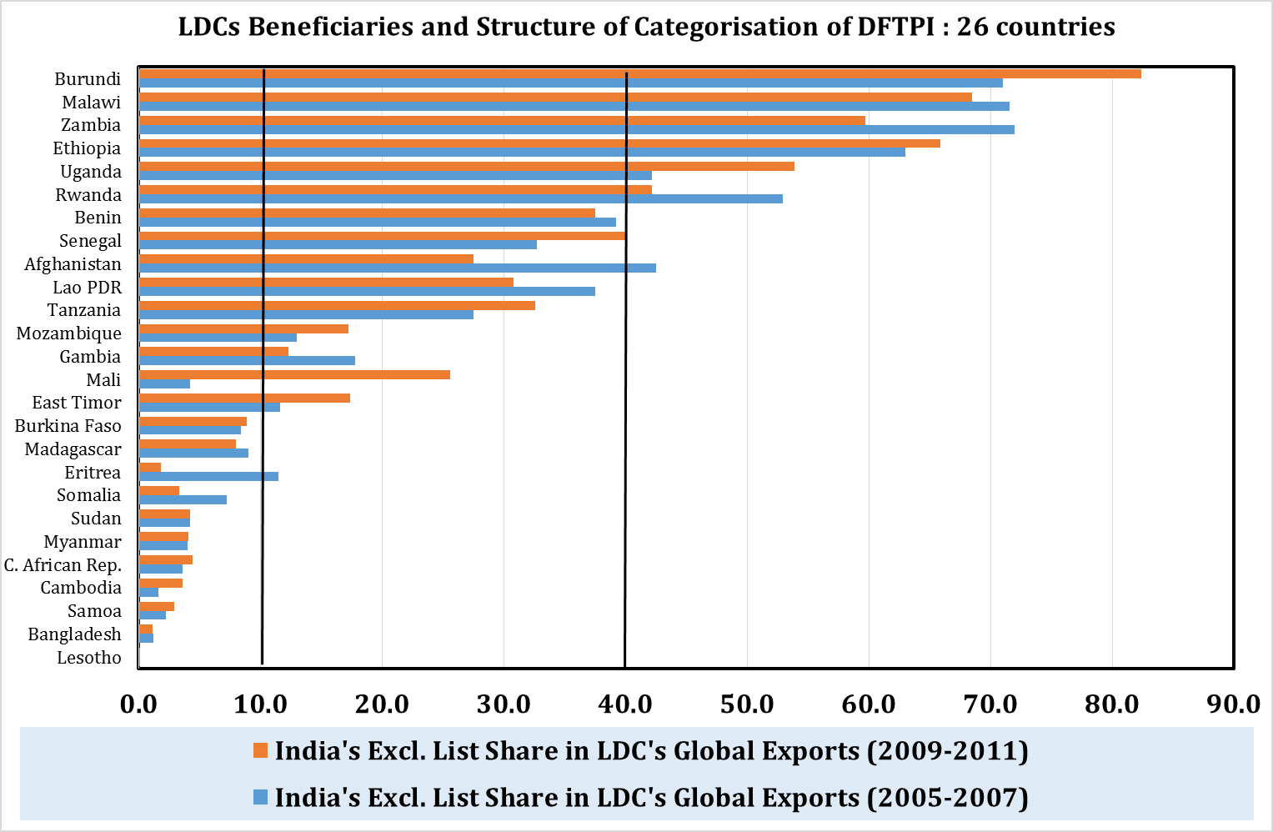
< 10 % not disadvantaged
> 11 to < 40 moderately disadvantaged.
> 41 highly disadvantaged.

Slide 16
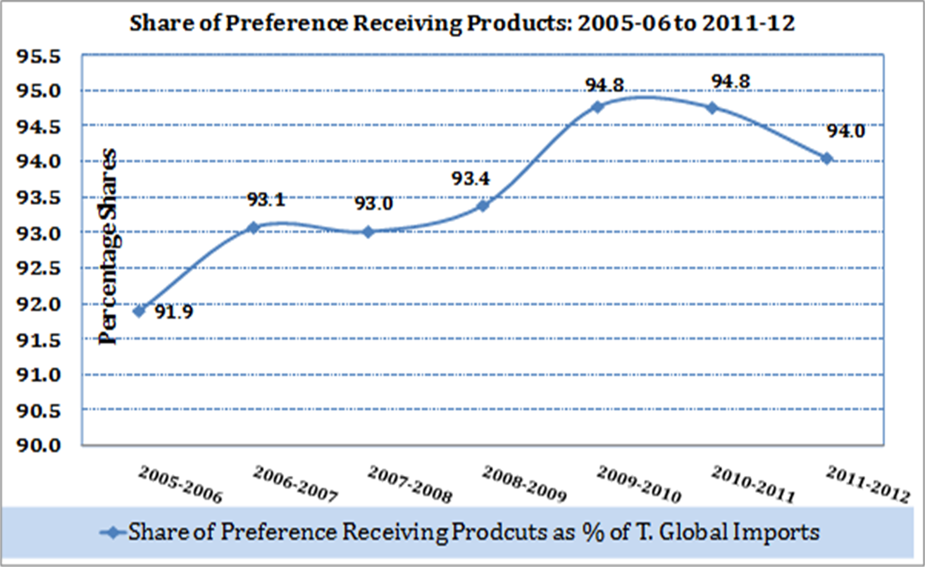
LDC Share in India's Imports of Preference Products
Year | Share of Preference Products as % of Total Global Imports
2005-06 | 91.9
2006-07 | 93.1
2007-08 | 93.0
Pre-DFTP (2005/06 to 2007/08) | 92.7
2009-10 | 94.8
2010-11 | 94.8
2011-12 | 94.0
Post-DFTP (2009/10 to 2011/12) | 94.5

Slide 17
IS THE DFTP RELEVANT
85 % of global exports of the 29 LDCs in preference products
On average, 16 of top 20 global exports covered by preferences
LDCs have the supply capacity to benefit
Imports of preference products comprise 94 % of India’s total imports
Import demand for preference products exists in India

Slide 18
Analysis of trends in trade

Slide 19
difference in export growth of Preference Products and non Preference products

Slide 20
Aggregate level:
average export growth of the 26 Beneficiary Countries - 58 %
Preference Products overall growth of 62.2 %
In 16 countries Preference Products had higher export growth than non- Preference Products

Slide 21
Distribution of Beneficiary Countries exports to India of Zero-duty Products: Bilateral export growth >100 %

Slide 22
Impact of deepening of concessions
Country | 2008-09 |  | 2011-12
 | No. of Preference Products with Export Growth >75% | Share in Total Exports by Value | No. of Preference Products with Export Growth >75% | Share in Total Exports by Value
Cambodia | 50 | 97.6 | 104 | 94.2
Tanzania | 61 | 75.5 | 213 | 76.2
Malawi | 14 | 93.0 | 18 | 90.3
Mozambique | 16 | 64.0 | 106 | 93.3
Myanmar | 64 | 1.0 | 621 | 27.1
Uganda | 27 | 13.8 | 61 | 47.3
Ethiopia | 33 | 46.7 | 150 | 92.9
Madagascar | 32 | 14.0 | 144 | 65.3

Slide 23
Export growth by export specialisation sectors
 | Pre DFTP (Mn $) | Post- DFTP (Mn $) | Change (%) | Share in Total (Pre DFTP) | Share in Total (Post DFTP)
Oil-Exporting Beneficiary Countries | 272.3 | 465.5 | 70.95 | 15.81 | 16.66
Minerals-exporting Beneficiary Countries | 146.3 | 156.2 | 6.77 | 8.49 | 5.59
Services-exporting Beneficiary Countries | 42.5 | 74.3 | 74.82 | 2.47 | 2.66
Mixed-exporting Beneficiary Countries | 946 | 1496.3 | 58.17 | 54.92 | 53.54
Manufactures-exporting Beneficiary Countries | 218.4 | 401.9 | 84.02 | 12.68 | 14.38
Agriculture & Food-exporting Beneficiary Countries | 97.1 | 200.6 | 106.59 | 5.64 | 7.18
Total | 1722.6 | 2794.8 | 62.24

Slide 24
Difference in bilateral and global export growth of preference products

Slide 25
Preference Products where Bilateral Growth > global Export Growth

Slide 26
Overall Conclusion
Country | Bilateral Export Growth of Preference Products higher than overall bilateral exports of LDC | Bilateral Export Growth (Preference) higher than LDC Global Export Growth in Preference Products | Bilateral Imports Growth Of India higher than World Import Growth of India in Preference products
Bangladesh | Yes | Yes | Yes
Benin | Yes | Yes | Yes
Cambodia | Yes | Yes | Yes
East Timor | Yes | Yes | Yes
Lao PDR | Yes | Yes | Yes
Malawi | Yes | Yes | Yes
Mozambique | Yes | Yes | Yes
Senegal | Yes | Yes | Yes
Ethiopia | No | Yes | Yes
Madagascar | Yes | Yes | No
Somalia | Yes | Yes | No
Tanzania | No | Yes | Yes
Uganda | Yes | Yes | No
Eritrea | No | No | No
Rwanda | No | No | No
Samoa | No | No | No
Zambia | No | No | No

Slide 27
Recommendations
In Afghanistan; Benin; Burundi; Ethiopia; Malawi; Rwanda; Uganda and Zambia mismatch between products of export strength and products receiving preferences under the Scheme.
Remove specific products of export interest of these countries from the Exclusion List.
Modify Exclusion List so that not more than 2-3 top 20 exports in the List
Disseminate information about the Scheme and EXIM procedures

Slide 28
Recommendations
Building productive capacities – need for country-specific initiatives
Creating premium brands based on Geographical Indications
Sudan’s extra long staple Barakat cotton; Tanzania Blackwood; Mozambique cashew; Uganda vanilla; Madagascar cocoa; Ethiopian Cabretta and Bati leather
Strengthening Services link with manufacturing

Slide 29
THANK YOU

